Slide 1





Introduction to Python
Learn to Code 2018

Slide 3
github.com/oxcompsoc/learntocode
Notes:
All the resources are available on GitHub
Some of the resources are still based on last year’s course but they will be updated as we go along this year

Slide 4


Slide 5
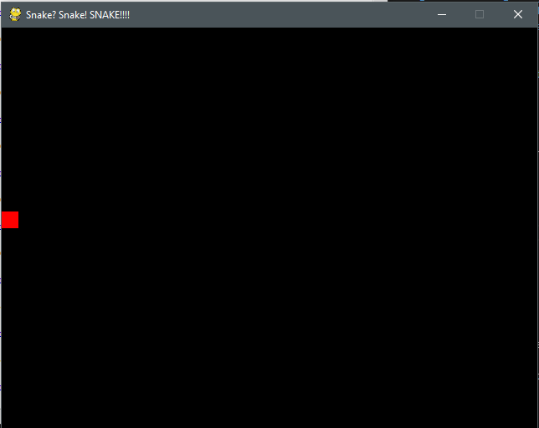

Slide 6
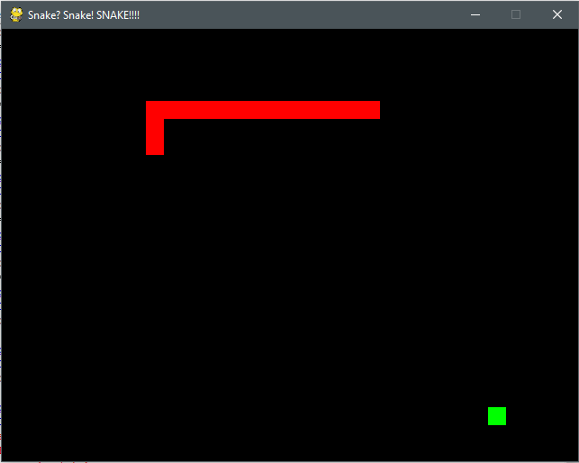

Slide 7
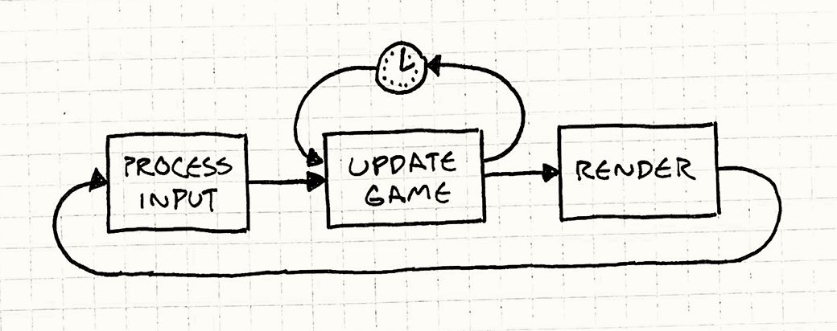

Slide 8
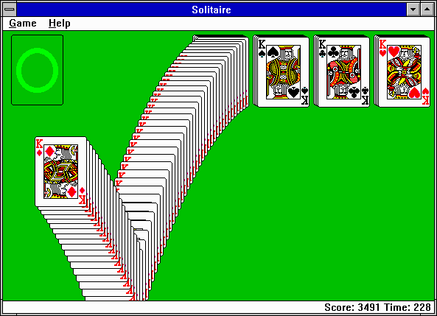

Slide 9
github.com/oxcompsoc/learntocode
Notes:
All the resources are available on GitHub
Some of the resources are still based on last year’s course but they will be updated as we go along this year

Slide 10

python.org

Slide 11


Slide 12
projecteuler.net

Slide 13
numpy.org
scipy.org

Slide 15
opencv.org

Slide 18
Thank You!

